Slide 1


DOCTOR APPOINTMENT SYSTEM

Slide 2
Prepared by
Juthy Akther
ID: 20103246
Supervisor
Snaholata Mondal
Lecturer, Dept. Of CSE, IUBAT

Slide 3

Topics to be covered
Introduction of Organization
Project Overview
Process Model
Requirement Engineering
System Planning
Cost Estimation
Risk Management
Analysis Modeling
Project Demonstration
Limitation
Future Plan
Conclusion

Slide 4
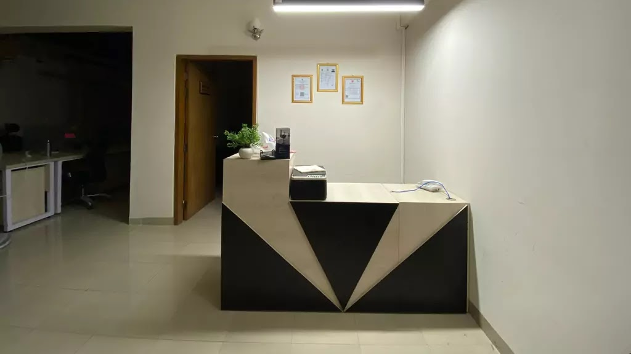
ABOUT ORGANIZATION

Slide 5

Organization
Name :
SOLUTYA PVT. LTD.
Adress:
Imagine Osman Center, Holding No. 34 (Islami Bank Building, Road Sonargaon Janapath, Dhaka 1230

Slide 6
Organization Overview
Solutya Pvt. Ltd., the premier software company in Dhaka and Uttara.
They provides customized web- based solutions including Custom Websites, e-commerce portal, Personal or Business portfolio and management solutions.
They build easy to use, fast and beautiful native and non-native mobile applications for iOS and Android Devices.
Based on client’s requirement, puts its professional team and process planning to work and is able to attain goals and objectives for the benefit of the client.

Slide 7

Project overview

Slide 8
Introduction
“The doctor appointment system ”streamlines scheduling and managing appointments between patients and doctor’s
It leverages technology to offer patients the convenience of booking appointments, checking doctor list, get notification and have access of own profile.
Doctor can check all patient list and accept the appointment.
The system aims to improve the patient experience by reducing wait times, minimizing administrative burdens, and enhancing access to appointment services, contributing to better care and satisfaction

Slide 9
System Benefits
It streamlines the appointment process, reducing waiting times for patients and optimizing the schedule for Doctors.
Patients can conveniently book appointments at their preferred times, check doctor availability, and receive notification.
Patients can access the system through various platforms (online, mobile apps, phone), making it easier to book appointments regardless of location or time.
Patient can easily take appointment through online , don’t need to wait for long time.

Slide 10

Process Model

Slide 11
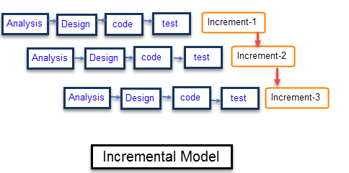
Incremental Process Model

Slide 12
Incremental Process Model Cont…
Why Incremental Model ?
In this model user can respond to each built.
Lowers initial delivery cost.
Software will be generated quickly during the software life cycle.
It is flexible and less expensive to change requirements and scope.
Thought the development stages changes can be done.
Errors are easy to be identified.
Generates working software quickly and early during the software life cycle.

Slide 13
Requirement Engineering

Slide 14
Requirements
User Requirements.
System Requirements.
Functional Requirements.
Non-Functional Requirements.

Slide 15
Requirements Contd…
Admin
User Requirements
1. Admin can approve application.
System Requirements
1.1 Admin need to be login first.
1.2 There will be a button named “Applications” in the dashboard of the admin.
1.3 Admin can approve doctor.
1.4 There will a button named ”reject” on applications, admin can reject application as well.
Functional Requirements
1. There will be a button named “Applications” in the admin panel.
2. Clicking the ”Applications” button will bring up the list of all application .
3. Clicking on ”profile” button will redirect the admin to the profile .
4. If the ”Accept” button is clicked the doctor will add to the database and the system.
5. If the ”Reject” button is clicked, the doctor will remove from the system.

Slide 16
Requirements Contd…
User Requirements
2. Admin can check all appointments.
System Requirements
2.1Admin need to be login first.
2.2 There will be a button named “appointments” in the dashboard of the admin.
2.3 Admin can change the action status.
Functional Requirements
1. There will be a button named “appointments” in the admin panel.
2. Clicking the ”appointments” button will bring up the list of all appointments .
3. Clicking on ”profile” button will redirect the admin to the profile .
4. If the ”Action” button is clicked the status will be change.

Slide 17
Requirements Contd…
User Requirements
3. Admin can check all users list.
System Requirements
3.1Admin need to be login first.
3.2 There will be a button named “All users” in the dashboard of the admin.
3.3 Admin can check all users list.
3.4 Admin can click on “Remove” button to remove user.
Functional Requirements
1. There will be a button named “All Users” in the admin panel.
2. Clicking the ” All Users” button will bring up the list of All Users.
3. “All User ”file store the information of all user.
4. If the ”Remove ” button , if clicked user will be deleted from database.

Slide 18
Requirements Contd…
User Requirements
4. Admin can check all Doctor list.
System Requirements
4.1Admin need to be login first.
4.2 There will be a button named ”All Doctors” in the dashboard of the admin.
4.3 Admin can remove doctor.
4.4 There will a button named ”remove” all doctors list, admin can reject application as well.
Functional Requirements
1. There will be a button named “All Doctors” in the admin panel.
2. Clicking the ” All Doctors” button will bring up the list of All Doctors.
3. Clicking on ”profile” button will redirect the admin to the profile .
4. If the ” Remove” button is clicked, the doctor will remove from the system.

Slide 19
Requirements Contd…
Doctor
User Requirements
1. Doctor need to be login first.
System Requirements
1.1 Doctor need to be register first.
1.2 There will be a button named “Profile” in the navbar of the doctor.
1.3 doctor can update profile.
1.4 system can store the doctor information.
Functional Requirements
1.There is a login registration authentication functionality.
2. Clicking the ”Profile” button will bring up the doctor's profile.
3. Clicking on ”profile” button there is a update profile functionality.

Slide 20
Requirements Contd…
User Requirements
2. Doctor can apply as a doctor.
System Requirements
2.1 System will check the login authentication.
2.2 There will be a button named ”Apply for doctor” the navbar of the doctor.
2.3 doctor can update profile.
2.4 system can store the applicable doctor information.
Functional Requirements
1.There is a login registration authentication functionality.
2. Clicking the ” Apply for doctor” button will bring up the apply page.
3. Clicking on ”Apply” button doctor application will submitted.

Slide 21
Requirements Cont…
User Requirements
3. Doctor can check all appointments
System Requirements
3.1 System will check the login authentication.
3.2 There will be a button named
”appointments” the navbar of the doctor.
3.3 The system store the appointment information to the database.
3.4 system can store doctor, patient name, appointment and booking date and time and status.
Functional Requirements
1.There is a login registration authentication functionality.
2. Clicking the ” appointments” button will bring up the appointments page.
3. Clicking on ”Action” button doctor can accept the appointment.

Slide 22
Requirements Contd…
User Requirements
4.Doctor can get the notification
System Requirements
4.1 System will check the login authentication.
4.2 There will be a button named
”notification” on the navbar of the doctor.
4.3 The system store the appointment and application update information to the database.
4.4 System give the update notification.
Functional Requirements
1.There is a login registration authentication functionality.
2. Clicking the ” notification” button will bring up the notification page.

Slide 23
Requirements Contd…
Patient
User Requirements
1. Patient need to be login first.
System Requirements
1.1 System confirm the registration before login.
1.2 System store the login and registration information.
1.3 patient can update profile.
1.4 system can store the update patient information.
Functional Requirements
1.There is a login registration authentication functionality.
2. Clicking the ”Profile” button will bring up the doctor's profile.
3. Clicking on ”profile” button there is a update profile functionality.

Slide 24
Requirements Contd…
User Requirements
2. Patient can book an appointment.
System Requirements
2.1 System confirm the registration before login.
2.2 System store the login and registration information.
2.3 patient can browse doctor page.
2.4 system can provide the all-doctors list.
2.5 system can provide the book appointment option.
Functional Requirements
1.There is a login registration authentication functionality.
2. Clicking the ”Doctors” button will redirect the doctors' page.
3. Clicking on ”Book Appointment” button there is a booking functionality.
4. In book appointment function there is a select date and time option.
5. There is a book appointment confirmation functionality available.

Slide 25
Requirements Cont…
User Requirements
3. Patient can check own appointments.
System Requirements
3.1 System confirm the registration before login.
3.2 System store the login and registration information.
3.3 patient can browse appointments page.
3.4 system can provide the all-appointments data.
Functional Requirements
1.There is a login registration authentication functionality.
2. Clicking the ” Appointments” button will redirect the Appointment page.
3. Clicking on ” Appointments” button redirect the appointments page.
4. In appointments page show all details of appointment.

Slide 26
Requirements Cont…
User Requirements
4. Patient can get Notifications.
System Requirements
4.1 System confirm the registration before login.
4.2 System store the login and registration information.
4.3 patient can browse Notifications page.
4.4 system can provide the all- Notifications data.
Functional Requirements
1.There is a login registration authentication functionality.
2. Clicking the ” Notifications” button will redirect the Notifications page.
3. Clicking on ” Notifications” button redirect the notifications page.
4. In Notifications page show all details of notifications.

Slide 27
Requirements Cont…
User Requirements
5. User can apply as a doctor.
System Requirements
5.1 System will check the login authentication.
5.2 There will be a button named ”Apply for doctor” the navbar of the doctor.
5.3 User can update profile.
5.4 system can store the applicable User information.
Functional Requirements
1.There is a login registration authentication functionality.
2. Clicking the ” Apply for doctor” button will bring up the apply page.
3. Clicking on ”Apply” button User application will submit.

Slide 28
Non-Functional Requirements
Showing pop up message after completion any action
Password will be encrypted
Usability, reliability & availability requirements must be ensured

Slide 29
Use Case Diagram

Slide 30
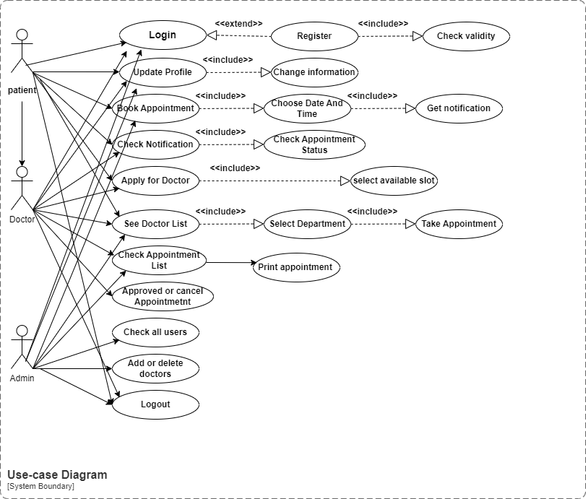

Slide 31
SYSTEM PLANNING

Slide 32
Function Point Estimation (function description)….
 | Functionality | Input | Output
1 | Admin can login by using username and password. | Email-id , password | Redirect to admin dashboard or error message.
2 | Admin can see all user list. | Users button | S.No, first Name, last name, email, phone no. , age, gender, is doctor, remove.
3 | Admin can remove users | Remove button, confirm button | Confirmation message or error message.
4 | Admin can see all doctors list. | Doctors button | S.No, first Name, last name, email, phone no. , experience, specialization, fees, remove.
5 | Admin can remove doctors | Remove button, confirm button | Confirmation message or error message.
6 | Admin can check all appointments | Appointments button | S.No , doctor, patients, appointment date and time , booking date and time, action and status.
7 | Admin can change the appointment status | Action button | Confirmation message or error message.

Slide 33
Function Point Estimation (function description)….
8 | Admin can see all Application list. | Application button | S.No, first Name, last name, email, phone no. , experience, specialization, fees, action.
9 | Admin can approve or reject Application. | Application button | Confirmation message or error message.
10 | Admin can set profile | Profile button | Name, website, email, age, phone no, address, password.
11 | Admin can update profile | update button | Confirmation message or error message.
12 | Patient can do registration | Signup button, name, email , password. | Redirect to the dashboard or error message / confirmation message.
13 | User can login using email and password. | Login button, Email-id , password | Redirect to user dashboard or error message.

Slide 34
Function Point Estimation (function description)….
 | Functionality | Input | Output
14 | users can see all doctors list. | Doctors button | Name, phone no. , experience, specialization, fees, available-slot.
15 | User can book appointment | Book appointment button. Select date and time | Confirmation message or error message.
16 | Patient can check own appointments | Appointments button | S.No , doctor, patients, appointment date and time , booking date and time, status.
17 | Patient can check own notifications | notifications button | S.No , date and time ,status.
18 | Patient can apply as a doctor | Apply as doctor button, Experience, specialization, fees, available-slot. | Confirmation message or error message.
19 | Users can contact . | contact button, enter name, email, message. | Confirmation message or error message.

Slide 35
Function Point Estimation (function description)….
 | Functionality | Input | Output
20 | User can set profile | Profile button | Name, website, email, age, phone no, address, password.
21 | User can update profile | update button | Confirmation message or error message.
22 | Doctor can do registration | Signup button, name, email , password. | Redirect to the dashboard or error message / confirmation message.
23 | Doctor can login using email and password. | Login button, Email-id , password | Redirect to Doctor dashboard or error message.
24 | Doctor can see all doctors list. | Doctors button | Name, phone no. , experience, specialization, fees, available-slot.
25 | Doctor can book appointment | Book appointment button. Select date and time | Confirmation message or error message.

Slide 36
Function Point Estimation (function description)….
 | Functionality | Input | Output
26 | Doctor can check appointments list. | Appointments button | S.No , doctor, patients, appointment date and time , booking date and time, status, action.
27 | Doctor can approve appointments. | Appointments button | Confirmation message or error message.
28 | Doctor can check own notifications. | notifications button | S.No , content, date, time.
29 | Doctor can contact . | contact button, enter name, email, message. | Confirmation message or error message.
30 | Doctor can set profile | Profile button | Name, email, age, phone no, address, password.
31 | Doctor can update profile | update button | Confirmation message or error message.

Slide 37
Function Point Estimation (Identifying Complexity (TF))
Transaction function | TF | Fields /File involvement | FTR | DET
Admin can login by using username and password. | EI | Fields: emil, password File: users, login | 1 | 2
Admin can see all user list. | EO | Fields: S.No, Name, email, phone no. , age, gender. File: users | 1 | 6
Admin can remove users | EI | Fields: Name, email, phone no. , age, gender. File: users | 1 | 5
Admin can see all doctors list. | EO | Fields: S.No, Name, email, phone no. , experience, specialization , fees. File: doctors | 1 | 7
Admin can remove doctors | EI | Fields: Name, email, phone no. , experience, specialization , fees File: doctors | 1 | 6

Slide 38
Function Point Estimation (Identifying Complexity (TF))
Transaction function | TF | Fields /File involvement | FTR | DET
Admin can check all appointments | EO | Fields: doctor, patients, appointment date and time , booking date and time, action and status. File: appointments | 1 | 8
Admin can approve or reject Application. | EO | Fields: doctor, patients, appointment date and time , booking date and time, action and status. File: Application | 1 | 8
Admin can set profile | EI | Fields: Name, website, email, age, phone no, address, password. File: profile | 1 | 7
User can login using email and password. | EI | Fields: Email-id , password File: login | 1 | 2
users can see all doctors list. | EO | Fields: Name, phone no. , experience, specialization, fees, available-slot. File: users | 1 | 6

Slide 39
Function Point Estimation (Identifying Complexity (TF))
Transaction function | TF | Fields /File involvement | FTR | DET
Patient can check own Applications | EO | Fields: S.No , doctor, patients, appointment date and time , booking date and time, status. File: Applications | 1 | 8
Patient can check own notifications | EO | Fields: S.No , date and time ,status. File: notifications | 1 | 4
Patient can apply as a doctor | EI | Fields: Apply as doctor button, Experience, specialization, fees, available-slot. File: apply | 1 | 5
Users can contact . | EI | Fields: contact button, enter name, email, message. File: contact | 1 | 4
User can set profile | EI | Fields: Name, website, email, age, phone no, address, password. File: profile | 1 | 7

Slide 40
Function Point Estimation (Identifying Complexity (TF))
Transaction function | TF | Fields /File involvement | FTR | DET
User can update profile | EI | Fields: Name, website, email, age, phone no, address, password. File: profile | 1 | 7
Doctor can do registration | EI | Fields: Signup button, name, email , password. File:registration | 1 | 4
Doctor can login using email and password. | EI | Fields: Email-id , password File:login | 1 | 2
Doctor can see all doctors list. | EO | Fields: Name, phone no. , experience, specialization, fees, available-slot File:doctors list | 1 | 6
Doctor can book appointment | EI | Fields: Select date and time File:appointment | 1 | 2

Slide 41
Function Point Estimation (Identifying Complexity (TF))
Transaction function | TF | Fields /File involvement | FTR | DET
Doctor can check appointments list. | EO | Fields: doctor, patients, appointment date and time , booking date and time, status, action. File: appointments, Request | 2 | 8
Doctor can approve appointments. | EO | Fields: Approved, Reject File: appointments | 1 | 2
Doctor can check own notifications. | EO | Fields: content, date, time. File: notifications | 1 | 3
Doctor can contact . | EI | Fields: enter name, email, message. File: Contact. | 1 | 3
Doctor can set profile | EI | Fields: Name, email, age, phone no, address, password. File: Profile | 1 | 2

Slide 42
Function Point Estimation (Identifying Complexity (DF))
Data Function | Fields/File involvement | RET | DET
Users (ILF) | S.No , Name, email , password, phone no. , age, gender. | 1 | 7
Doctors (ILF) | Name, email, password, age, gender, phone no. , experience, specialization , fees. | 1 | 9
Appointments (ILF) | doctor, patients, appointment date and time , booking date and time, action and status. | 2 | 8
Applications (ILF) | doctor, patients, appointment date and time , booking date and time, action and status. | 1 | 8
Profile (ILF) | Name, website, email, age, phone no, address, password | 1 | 7
Apply (ILF) | Apply as doctor button, Experience, specialization, fees, available-slot. | 1 | 5
Contact (ILF) | contact button, enter name, email, message. | 1 | 4
Registration (ILF) | Signup button, name, email , password. | 1 | 4
Login (ILF) | Email, password | 1 | 2

Slide 43
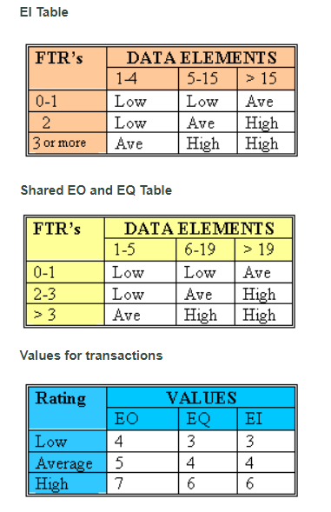

Slide 44
Function Point Estimation Cont… Unadjusted Function Point Contribution (TF)
Transection Function | FTR | DET | Complexity | UFP
Admin can login by using username and password. | 1 | 2 | Low | 3
Admin can see all user list. | 1 | 6 | Low | 4
Admin can remove users | 1 | 5 | Low | 4
Admin can see all doctors list. | 1 | 7 | Low | 4
Admin can remove doctors | 1 | 6 | Low | 4
Admin can check all appointments | 1 | 8 | Low | 4
Admin can approve or reject Application. | 1 | 8 | Low | 4
Admin can set profile | 1 | 7 | Low | 3
User can login using email and password. | 1 | 2 | Low | 3

Slide 45
Function Point Estimation Cont… Unadjusted Function Point Contribution (TF)
Transection Function | FTR | DET | Complexity | UFP
users can see all doctors list. | 1 | 6 | Low | 4
Patient can check own Applications | 1 | 8 | Low | 4
Patient can check own notifications | 1 | 4 | Low | 4
Patient can apply as a doctor | 1 | 5 | Low | 3
Users can contact . | 1 | 4 | Low | 3
User can set profile | 1 | 7 | Low | 3
User can update profile | 1 | 7 | Low | 4
Doctor can do registration | 1 | 4 | Low | 3
Doctor can login using email and password. | 1 | 2 | Low | 3

Slide 46
Function Point Estimation Cont… Unadjusted Function Point Contribution (TF)
Transection Function | FTR | DET | Complexity | UFP
Doctor can see all doctors list. | 1 | 6 | Low | 4
Doctor can book appointment | 1 | 2 | Low | 4
Doctor can check appointments list. | 2 | 8 | Avg | 5
Doctor can approve appointments. | 1 | 2 | Low | 4
Doctor can check own notifications. | 1 | 3 | Low | 4
Doctor can contact . | 1 | 3 | Low | 3
Doctor can set profile | 1 | 2 | Low | 3
Doctor can check own notifications. | 1 | 3 | Low | 4
Total UFP = 95

Slide 47
Function Point Estimation Cont… Unadjusted Function Point Contribution (DF)
Data Function | RET | DET | Complexity | UFP
Users (ILF) | 1 | 7 | Low | 7
Doctors (ILF) | 1 | 9 | Low | 7
Appointments (ILF) | 2 | 8 | Low | 7
Applications (ILF) | 1 | 8 | Low | 7
Profile (ILF) | 1 | 7 | Low | 7
Apply (ILF) | 1 | 5 | Low | 7
Contact (ILF) | 1 | 4 | Low | 7
Registration (ILF) | 1 | 4 | Low | 7
Login (ILF) | 1 | 2 | Low | 7
Total = 63

Slide 48
Function Point Estimation Cont… Performance and Environmental Impact
 | GSC | TDI
1 | Data Communication | 2
2 | Distributed Data Processing | 0
3 | Performance | 4
4 | Heavily Used Configuration | 2
5 | Transaction Rate | 1
6 | Online Data Entry | 3
7 | End-user Efficiency | 4

Slide 49
Function Point Estimation Cont… Performance and Environmental Impact
 | GSC | TDI
8 | Online Update | 3
9 | Complex Processing | 3
10 | Reusability | 2
11 | Installation Ease | 3
12 | Operational Ease | 3
13 | Multiple Sites | 4
14 | Facilitate Change | 3
Total Degree of Influence (TDI) = 35

Slide 50
Function Point Estimation Cont…
Final Calculation
Value adjustment factor (VAF) = (0.65 + (0.01 * TDI))
= (0.65 + (0.01 * 35))
= 1
Total UFP = UFP(TF) + UFP(DF)
= 95 + 63
= 158

Slide 51
Function Point Estimation Cont…
Final Calculation contd……
Adjusted Function Point Contribution(AFP)=Total UFP * VAF
=158 * 1
=158 Total Time Calculation Frame
= 11* 158
= 5959.75 Person Hours
= 1738 / 8 Person Days (Working 8 Hours a day)
= 217.25 Person Days
= 217.25 / 25 Man Months (25 working days a month)
= 8.69 Man Months
=8.69 / 4
= 2.1725
Approximately, 2.17 months is needed for 4 person to complete the project

Slide 52
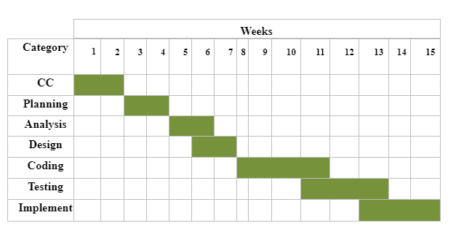
Project Scheduling Chart

Slide 53
Cost Estimation

Slide 54
Personnel Cost
• Number of days in a year = 365
• Number of government holidays in a year = 24
• Number of weekly holidays in a year = 53
• Total number of working days to develop the project =365-(53+24) =288 days
• Total number of working days per months to develop the project = 288/12 =24.083 days
• Organization working hours per month= 24 * 8 = 192 hours

Slide 55
Personnel Cost
Type | No. Of Members | Months | Salary(Taka)
System Analyst | 1 | 2 | 30,000
System Designer and Coder | 1 | 2 | 60,000
System Tester | 1 | 2 | 30,000
Total = 120000

Slide 56
Hardware Cost
Machine | Quantity | Parts | Quantity | Price (Taka) | Depreciation | Depreciation Cost | Total Cost
Desktop Computer | 1 | Motherboard | 1 | 10,000 | (10,000/12)*4 | 3,500 | 22,000
 |  | Processor | 1 | 10,000 | (10,000/12)*4 | 3,500
 |  | Core i7 RAM-8GB | 1 | 5000 | (5,000/12)*4 | 2,000
 |  | HDD | 1 | 5000 | (5,000/12)*4 | 2,000
 |  | Monitor | 1 | 20,000 | (20,000/12)*4 | 7,000
 |  | Keyboard | 1 | 500 | (500/12)*4 | 200
 |  | Mouse | 1 | 500 | (500/12)*4 | 200
Printer | 1 | printer | 1 | 15,000 | (15,000/12)*4 | 5,000 | 5,000
Total = 27,000 Taka

Slide 57
Software Cost
Name | Price
MS Office | 20,000
Windows 11 | 5,000
Visual Studio Code | 0.00
Mongo dB | 0.00
Others | 10,000
Total= 35,000

Slide 58
Final Cost
Purpose | Amount
Salary | 120,000
Software cost | 25,000
Hardware cost | 27,000
Other cost | 10,000
Total= 1,82,000 Taka

Slide 59
RISK MANAGEMENT

Slide 60
The RMMM Plan
Risk Mitigation: Proactive planning for risk avoidance.
Risk Monitoring: Assessing whether predicted risks occur or not, ensuring preventive steps are being properly applied, collect information for future risk analysis, attempt to determine which risks caused which problem.
Risk Management: Actions to be taken in the event that mitigation steps have failed and the risk has become a live problem.

Slide 61
Analysis Modelling

Slide 62
Activity Diagram of Admin

Slide 63
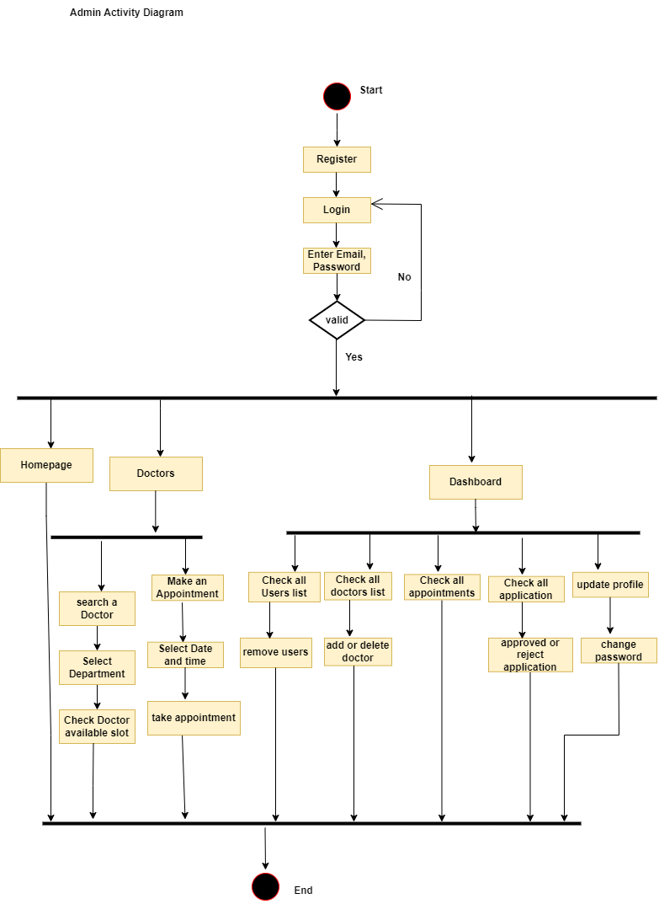

Slide 64
Activity Diagram of Patient

Slide 65
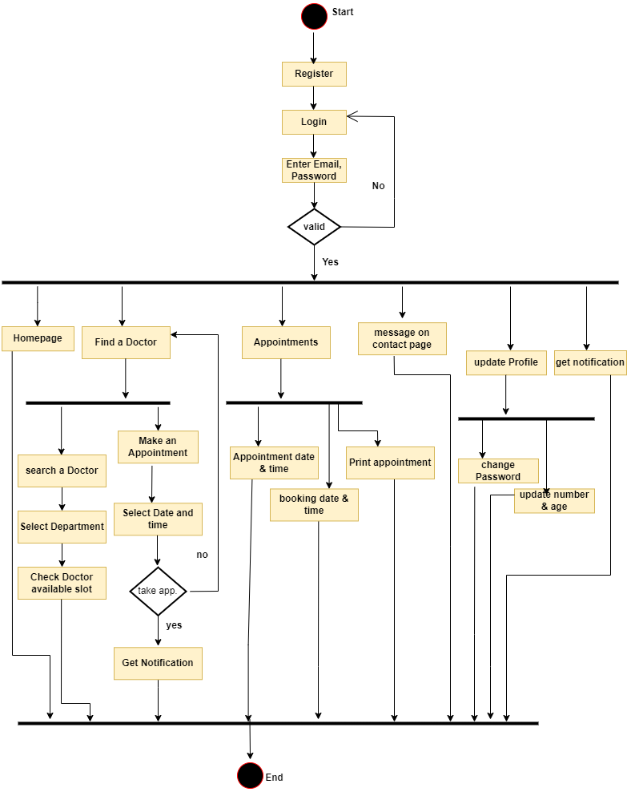

Slide 66
Activity Diagram of Doctor

Slide 67
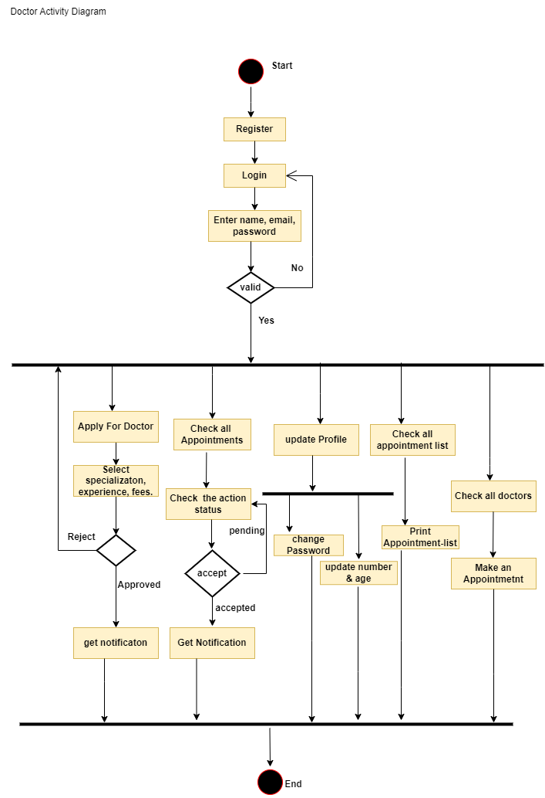

Slide 68
Swim Lane Diagrams

Slide 69
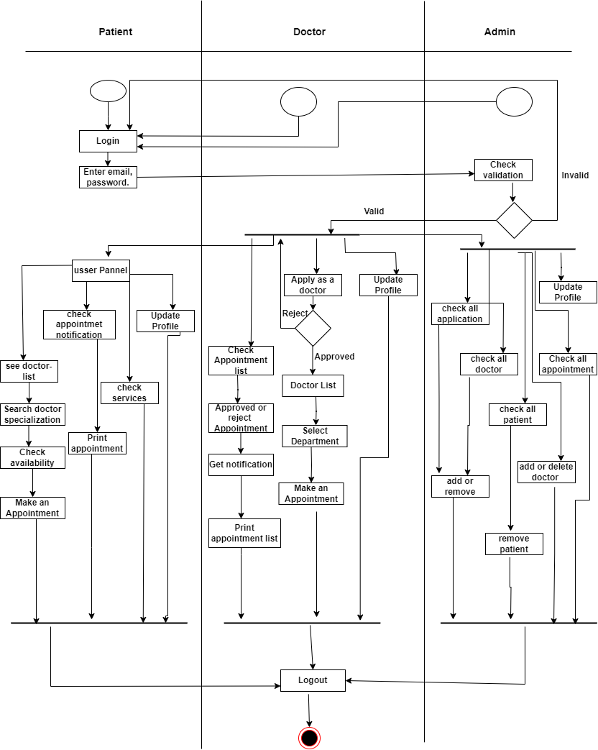

Slide 70
Sequence Diagrams for Admin

Slide 71
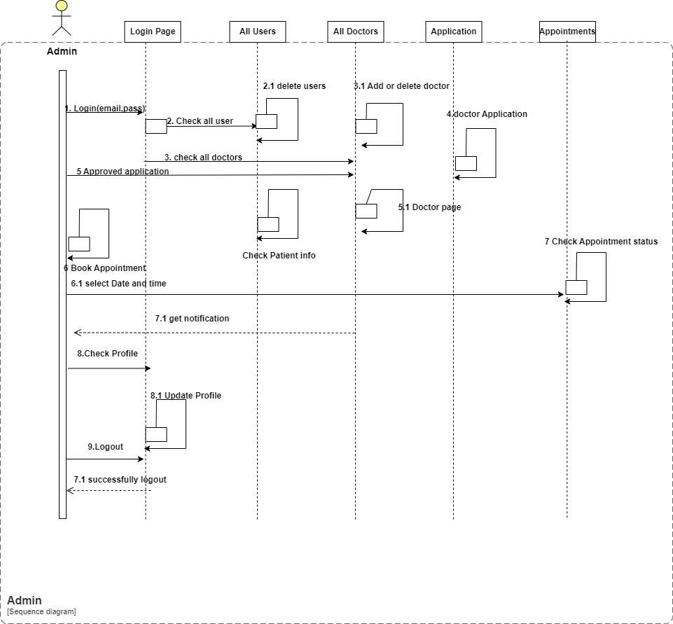

Slide 72
Sequence Diagrams for Patient

Slide 73
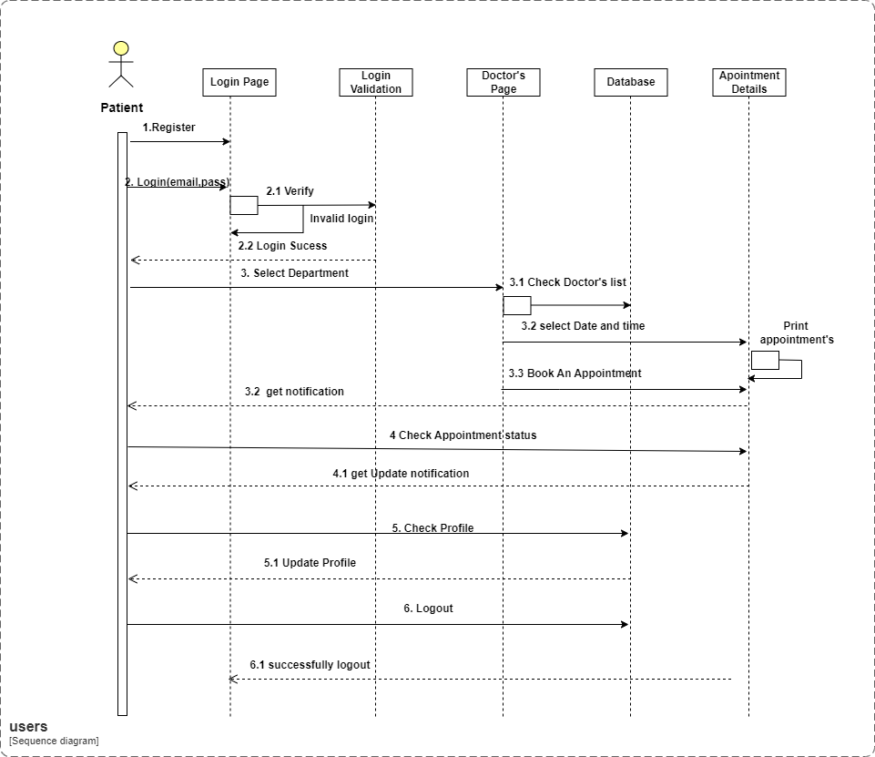

Slide 74
Sequence Diagrams for Doctor

Slide 75
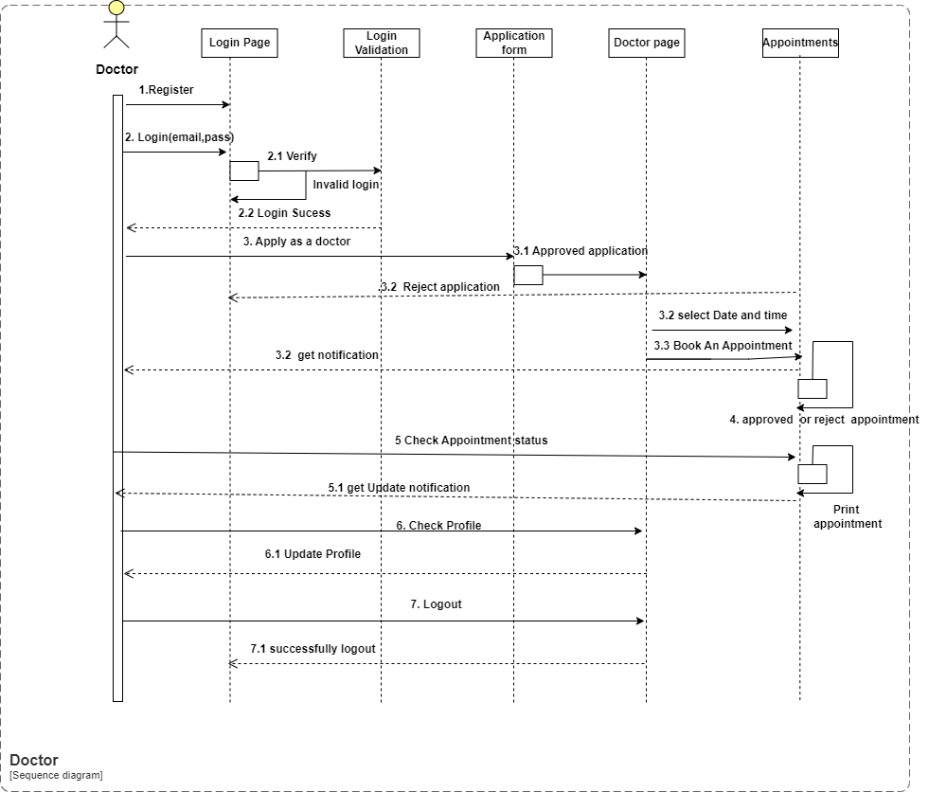

Slide 76
CRC

Slide 77
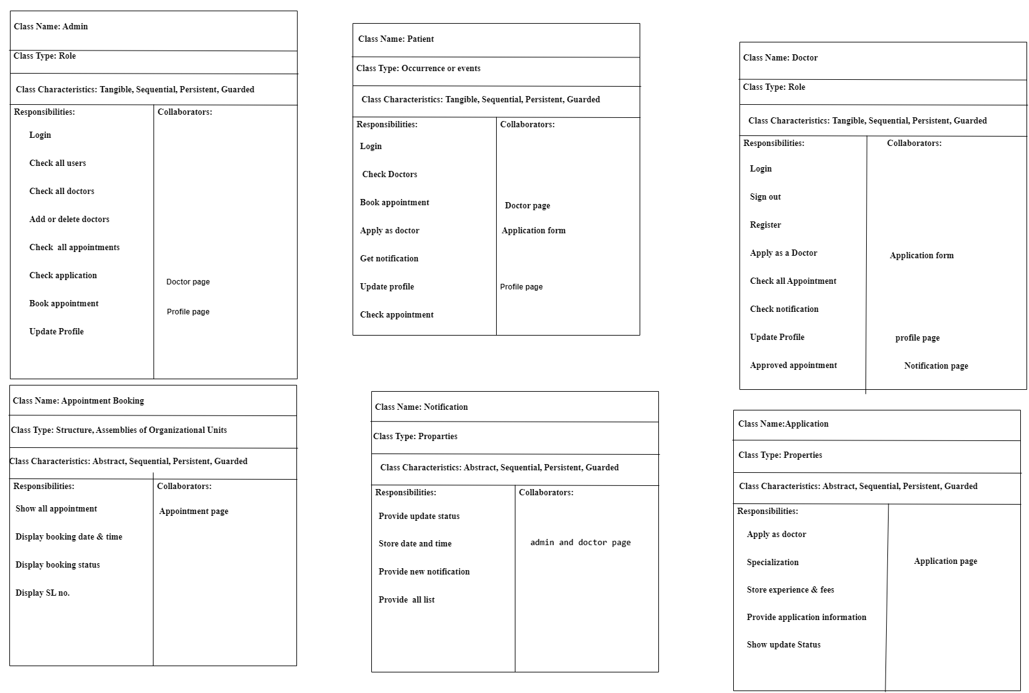

Slide 78
ERD

Slide 79
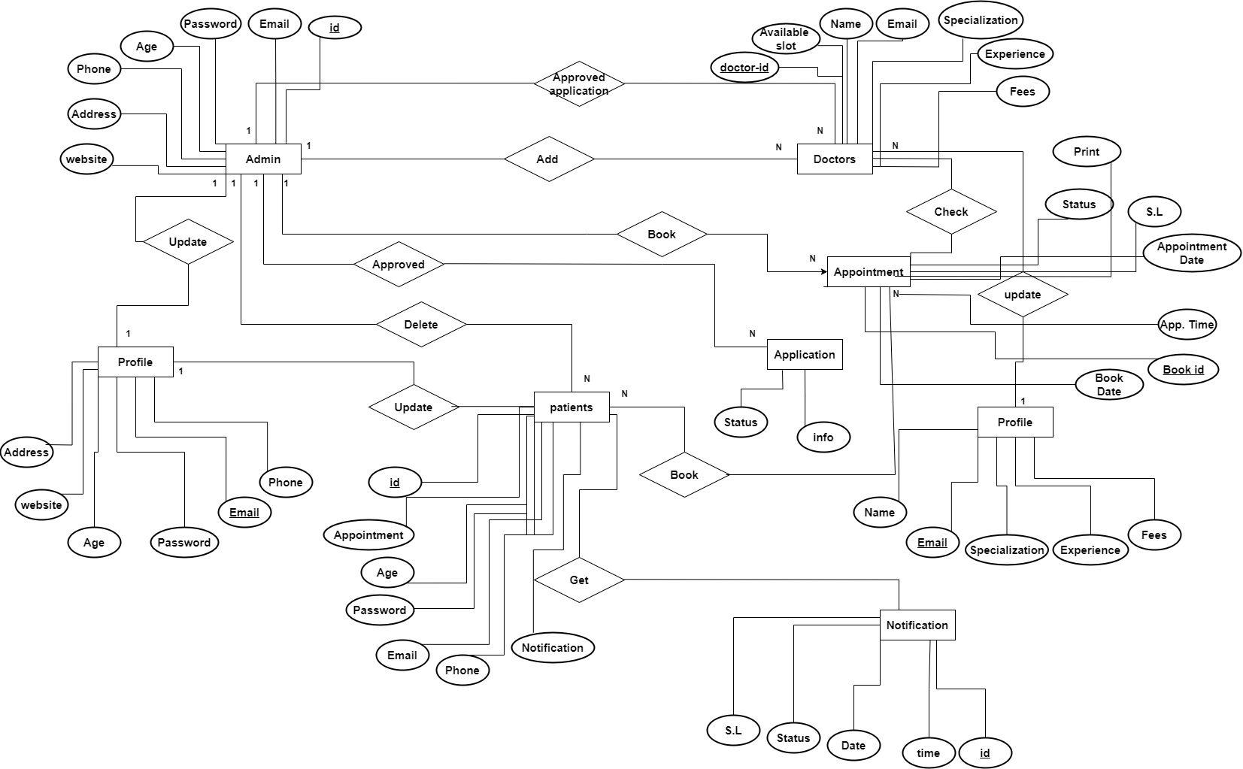

Slide 80
Data Flow Diagram

Slide 81
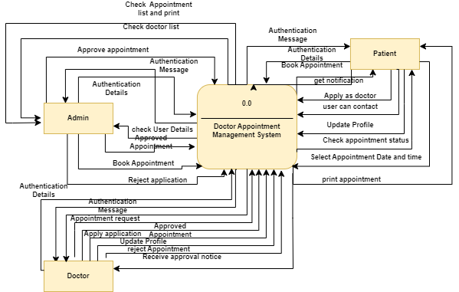
Context level DFD

Slide 82
Level 1 DFD

Slide 83
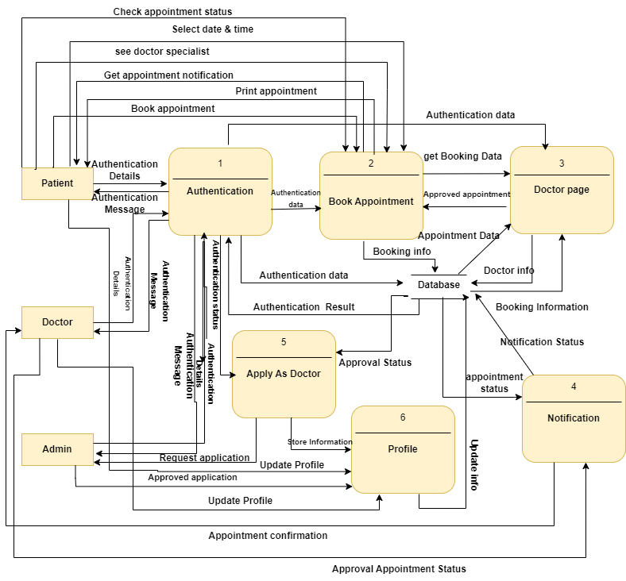

Slide 84
Level 2 DFD of Process 1

Slide 85
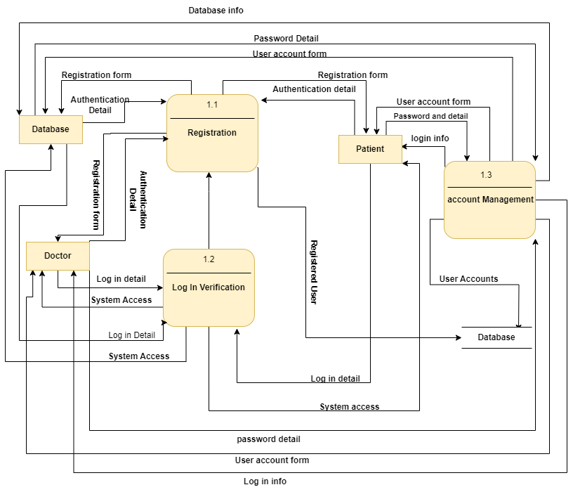

Slide 86
Level 2 DFD of Process 2

Slide 87
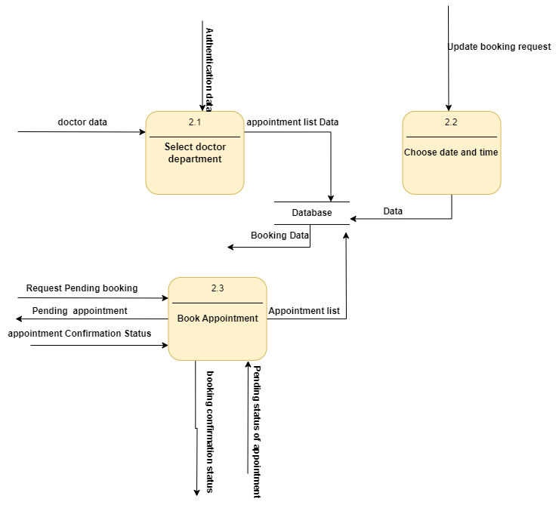

Slide 88
Level 2 DFD of Process 3

Slide 89
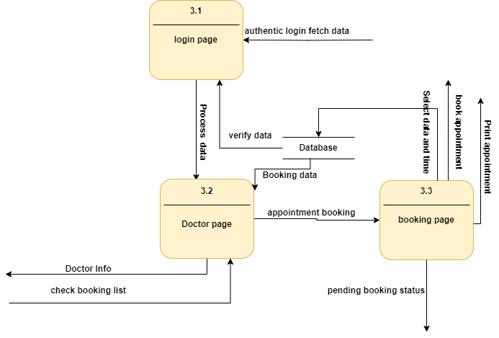

Slide 90
Level 2 DFD of Process 4

Slide 91
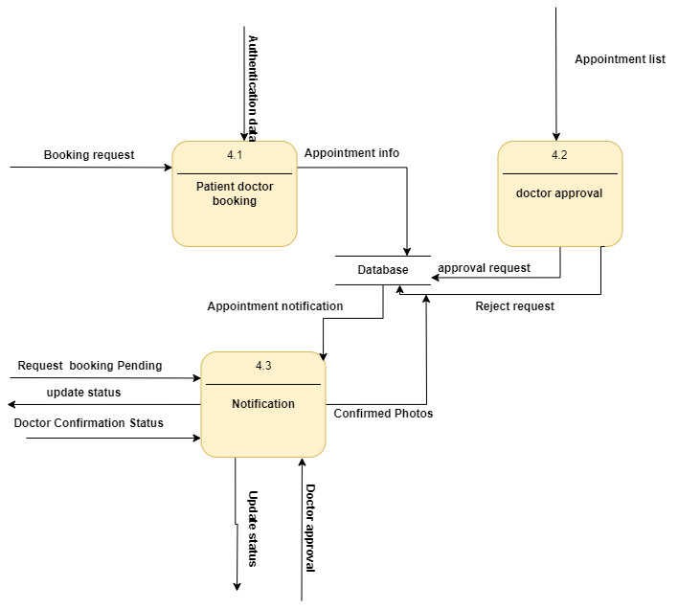

Slide 92


Slide 93
Limitations
Due time constraints, it was very difficult for me to build a perfect system. That’s why there are some limitations of this system.
Ø Platform Compatibility
Ø Limited Integration
Ø Password cannot be recovered through email

Slide 94
Future Plan
If I am given a chance to work further with this project, I have plans made to make the system more efficient for the users. The followings are the future plan for the System.
Payment can be added
Doctor Rejection option with message.
Admin can download all report.

Slide 95
Conclusion
A doctor appointment management system is a pivotal tool in modern healthcare.
It optimises workflows revolutionising the way patients access care and doctors manage their schedules.
Reduces administrative burdens, enhances patient satisfaction, and leads to more efficient and effective healthcare delivery.
Its integration fosters a seamless experience for both patients and healthcare providers,
Improving overall quality of care while maximising resource utilisation.

Slide 96
Thank YOU!!!
Any Questions?

